Slide 2
Robot 1
Robot 2
Robot 1
Robot 2

Slide 3
Robot 1
Robot 1

Slide 4
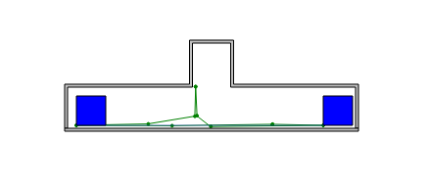

Slide 5
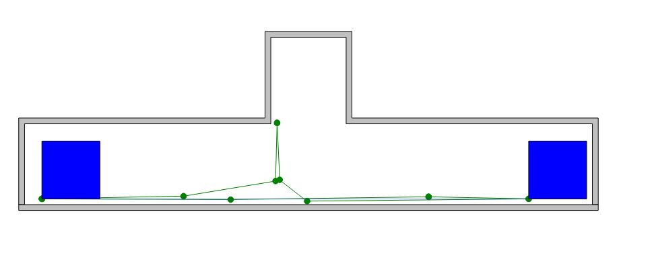

Slide 6
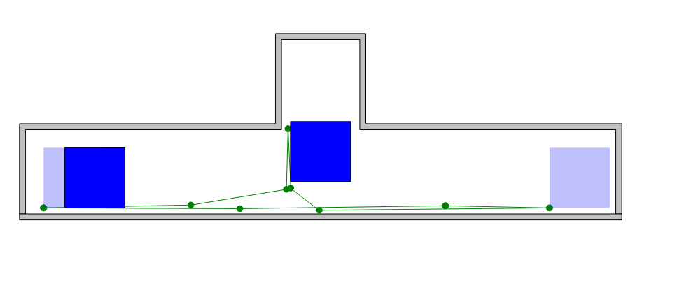

Slide 7
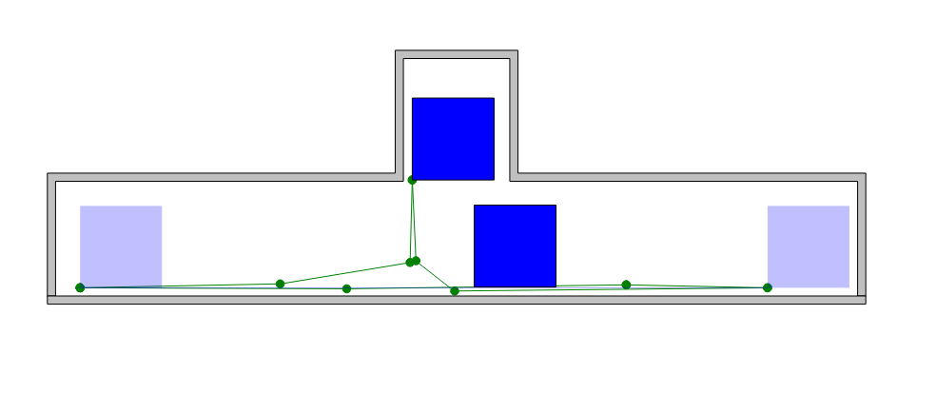

Slide 8
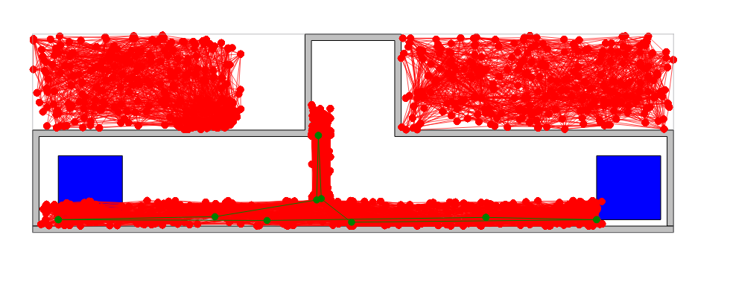

Slide 9
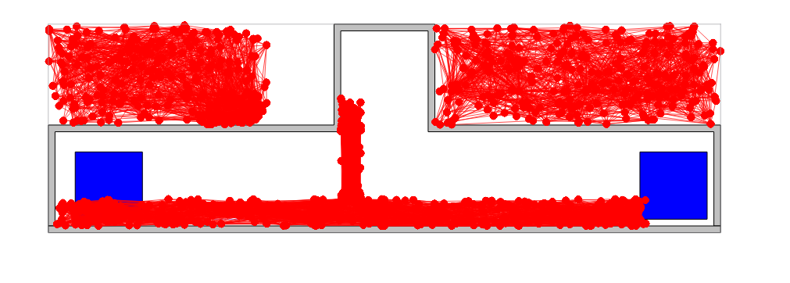

Slide 10
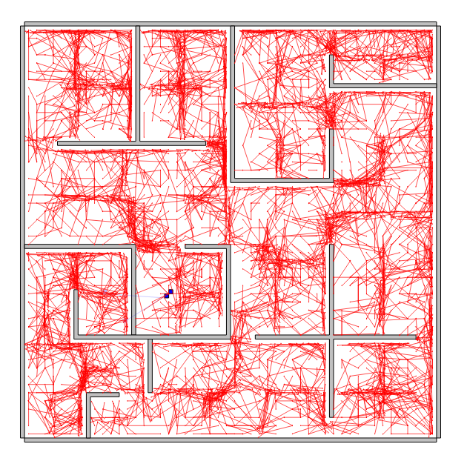
Notes:
N = 5000
k-=1 WITH reward distance

Slide 11
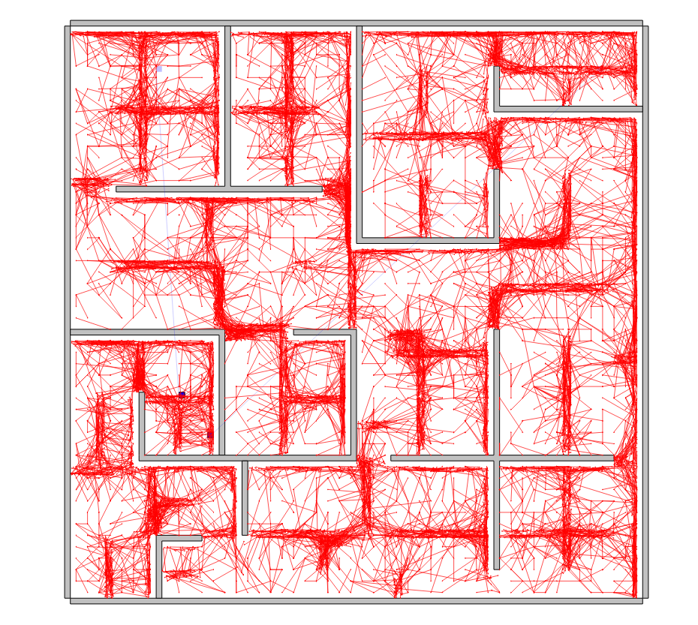
Notes:
N = 10000
k-=1 WITH no reward

Slide 12
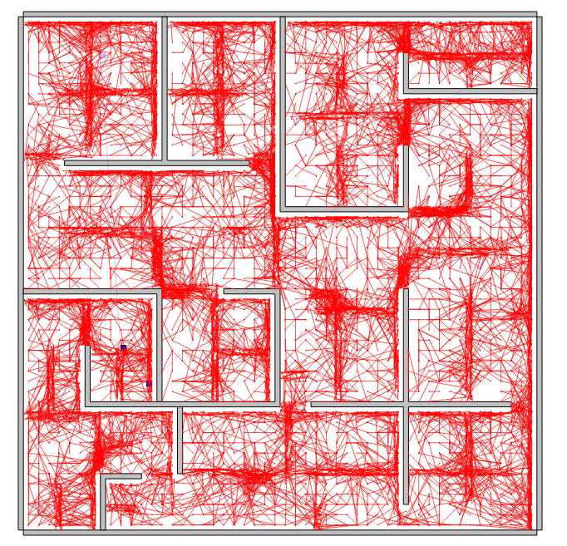
Notes:
N = 10000
k-=1 WITH distance reward

Slide 13
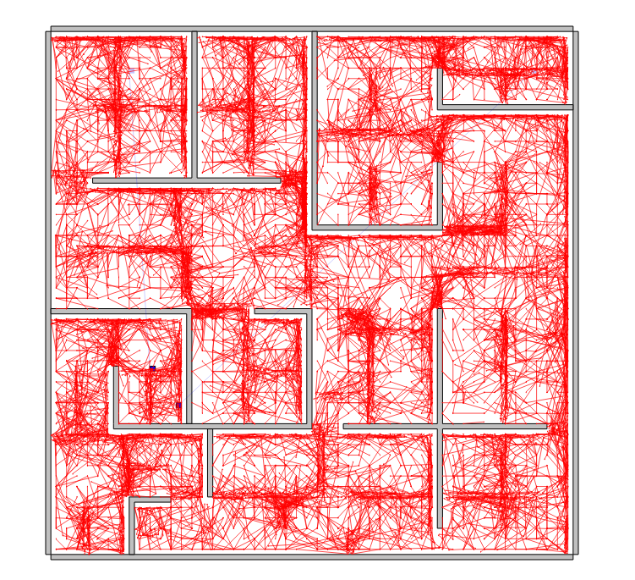
Notes:
k-=1 WITH 2* distance reward

Slide 14
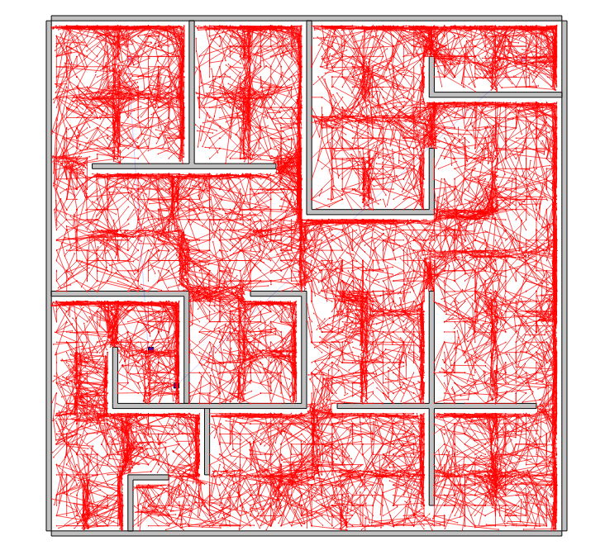
Notes:
k-=1 WITH 100* distance reward

Slide 15
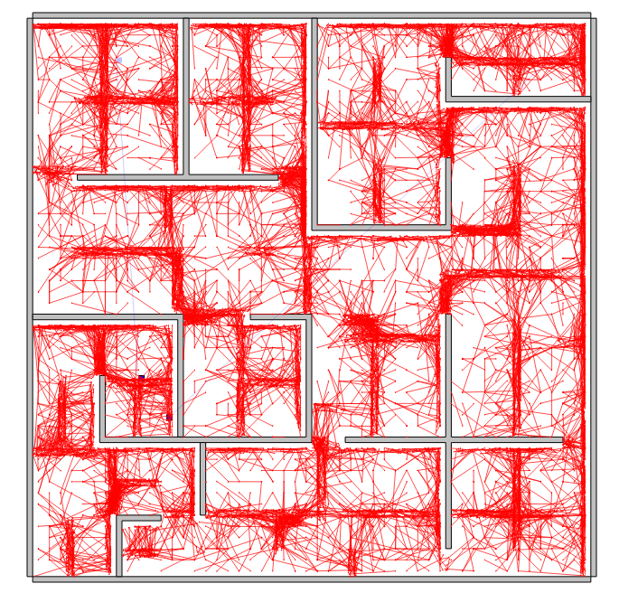
Notes:
N = 10000
k-=1 WITH no reward
No scale

Slide 16
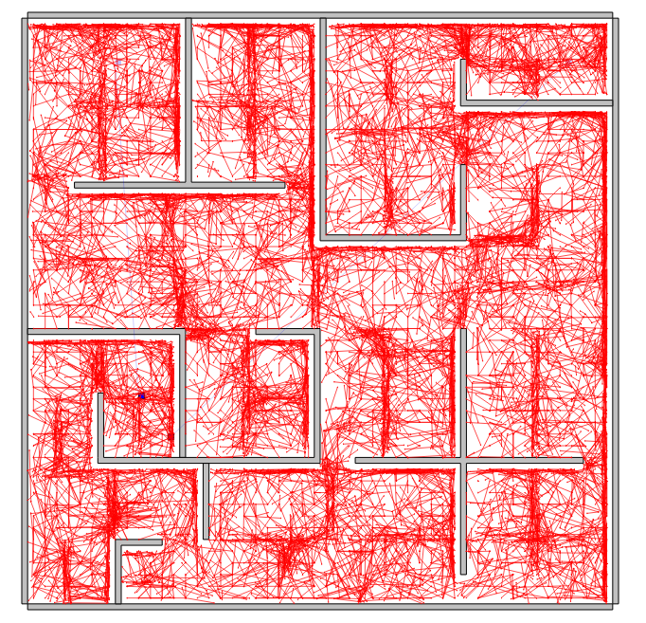
Notes:
N = 10000
k-=1 WITH reward
No scale

Slide 17
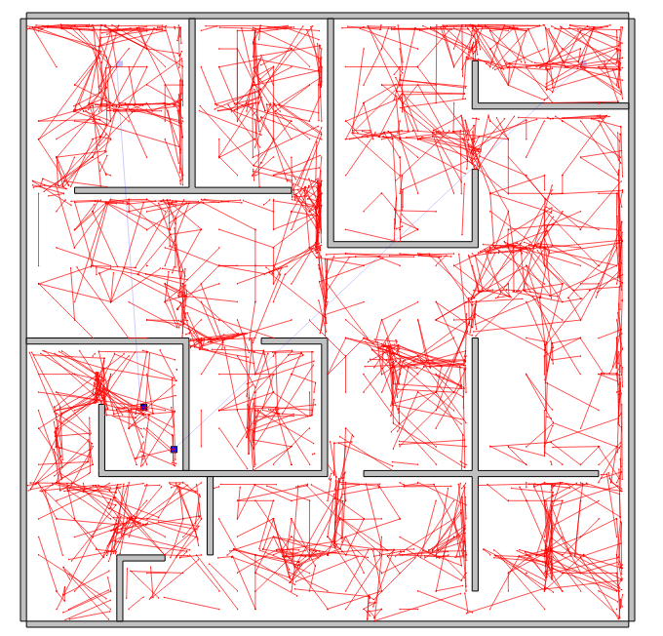

Slide 18
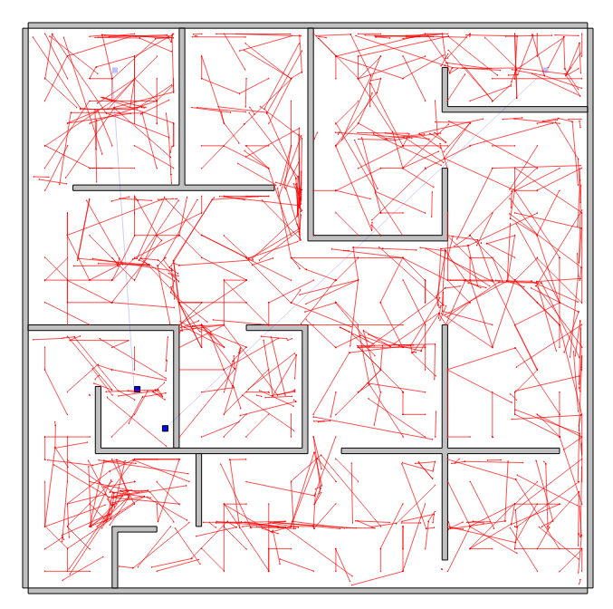

Slide 19
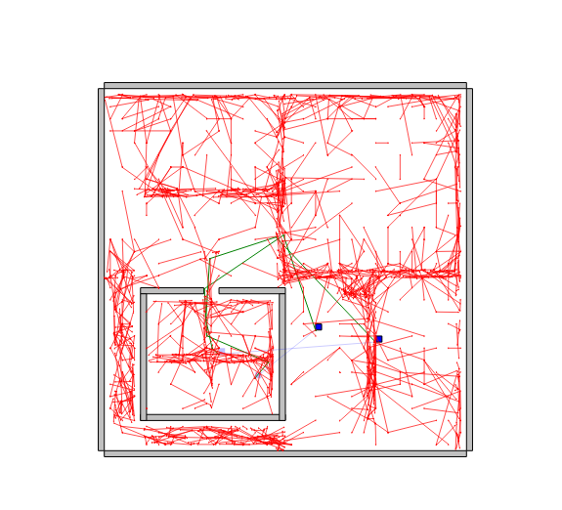
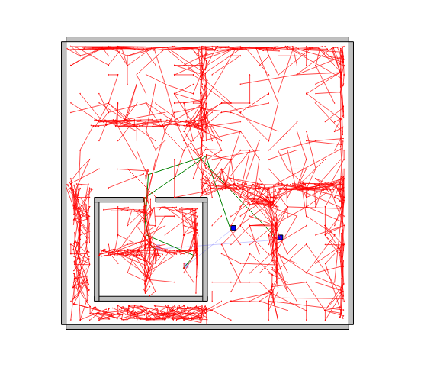
Notes:
N=1000
k-=1 WITH no reward
No scale

Slide 20
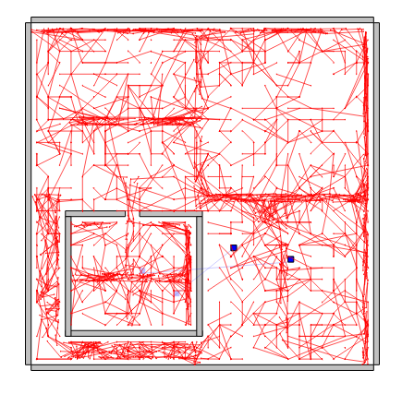
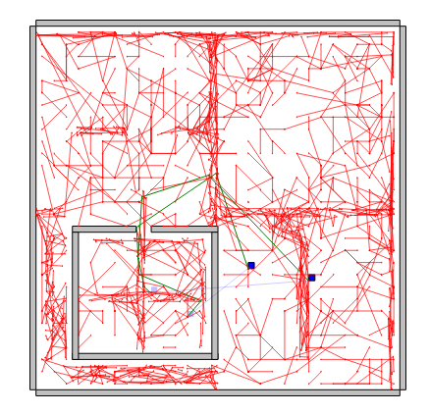
Notes:
N=1000
k-=1 WITH reward
No scale

Slide 21
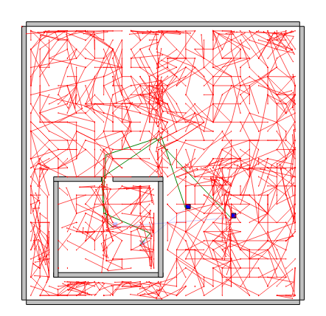
Notes:
N=1000
k-=1 WITH reward and adjust reward
No scale

Slide 23
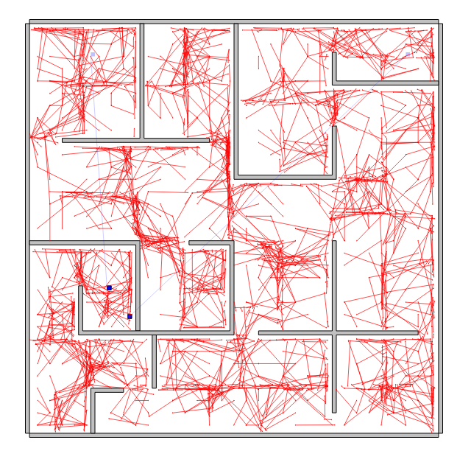
Notes:
No update (zero reward) n =2000
K=1

Slide 24
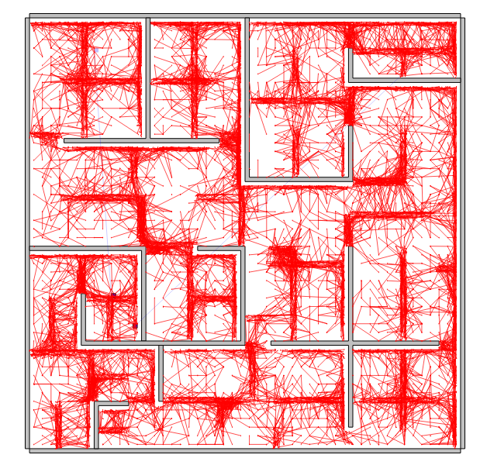
Notes:
No update (zero reward) n =10000
K=1

Slide 25
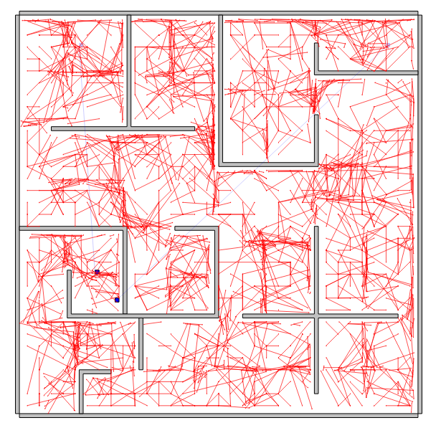

Slide 26
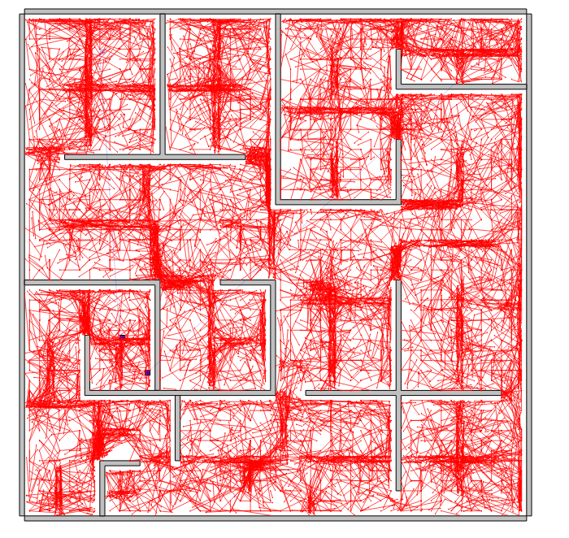

Slide 28
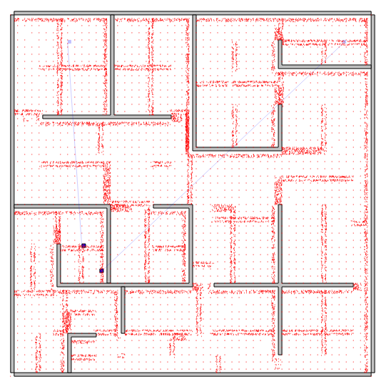
Notes:
N=10000
With reward

Slide 29
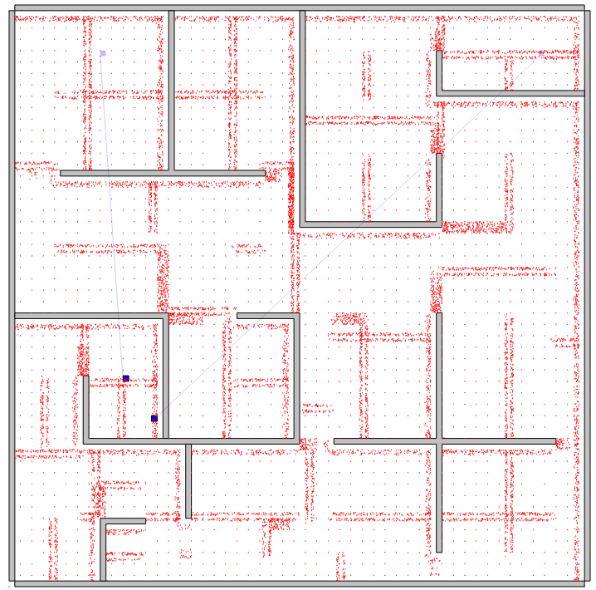
Notes:
N=10000
With no reward

Slide 30
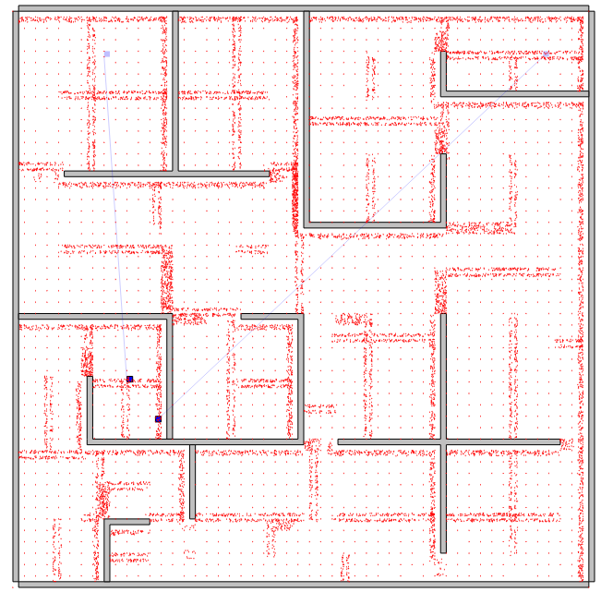
Notes:
N=10000
With and adjusted reward

Slide 31
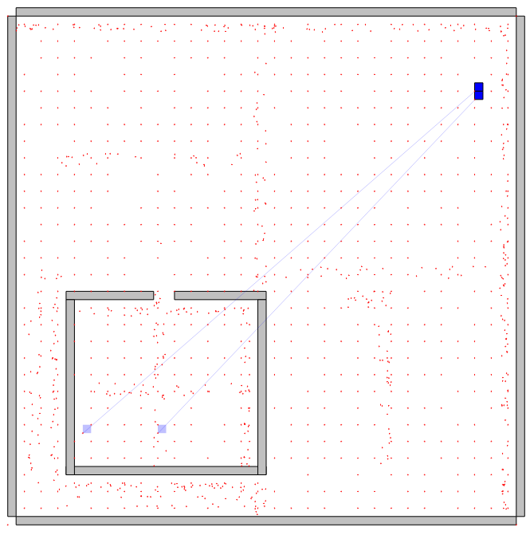
Notes:
N=1000s
With reward

Slide 32
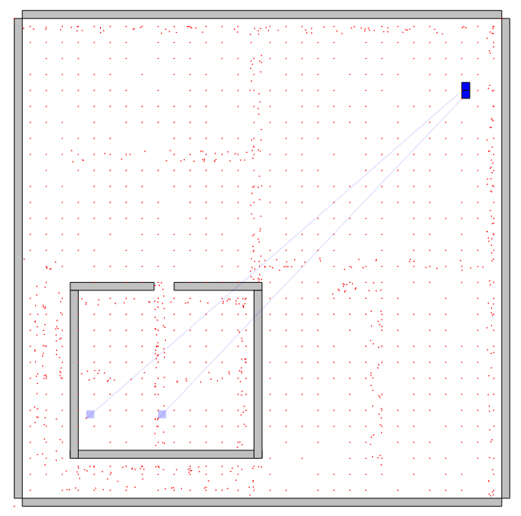
Notes:
N=1000
With and adjusted reward

Slide 33
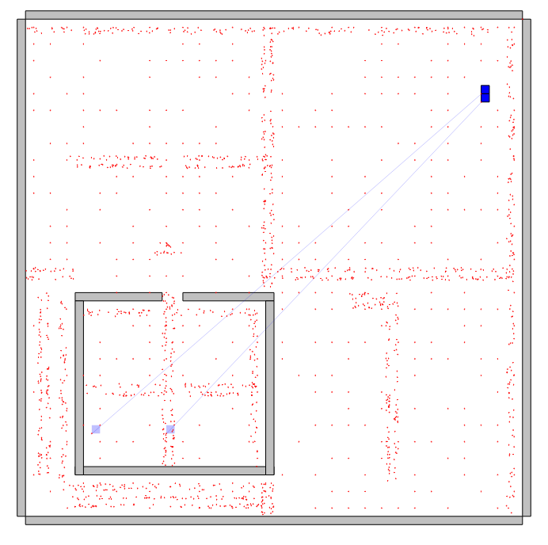
Notes:
N=1000
With no reward

Slide 35
With Uniform

Slide 36
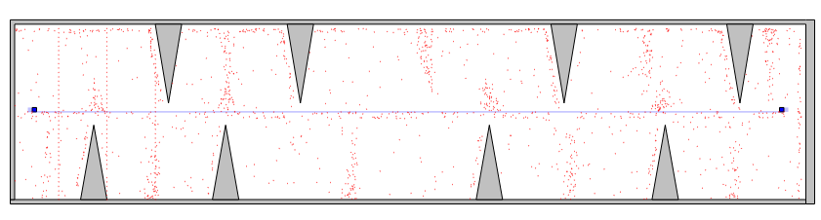
Notes:
N=1000 with no reward

Slide 37
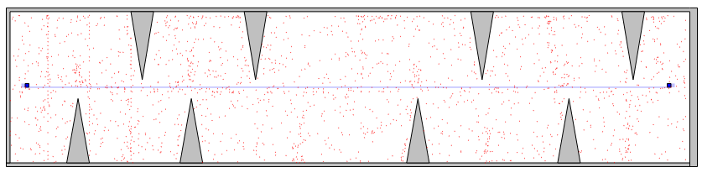
Notes:
N=1000 with adjusted reward

Slide 38
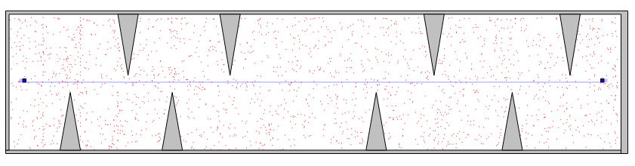
Notes:
N=1000 with reward

Slide 39
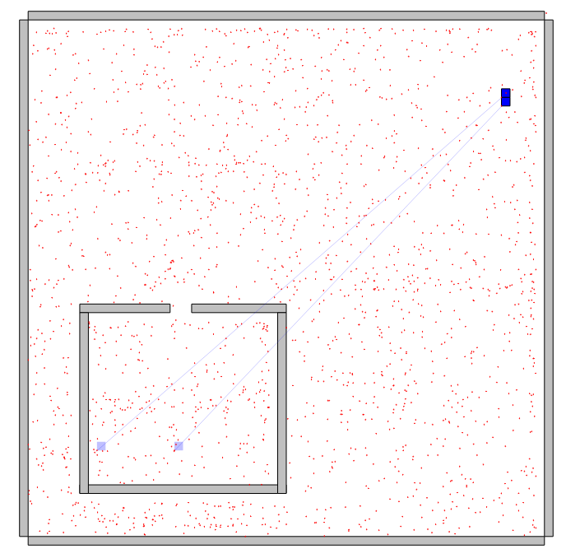
Notes:
N=1000 with reward

Slide 40
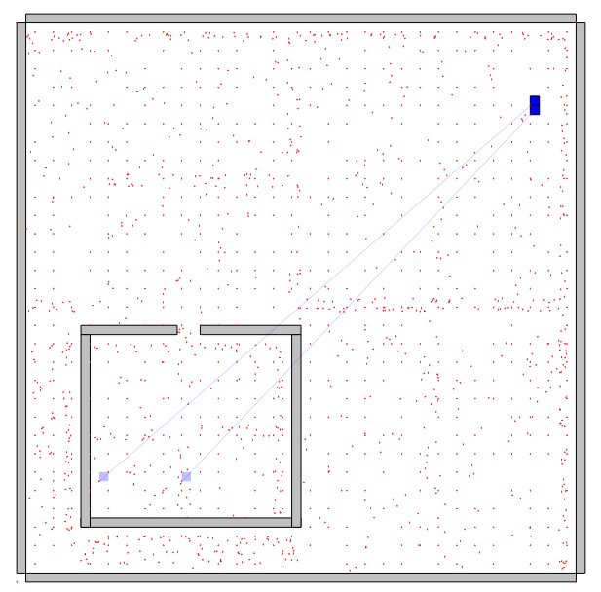
Notes:
N=1000 with adjusted reward

Slide 41
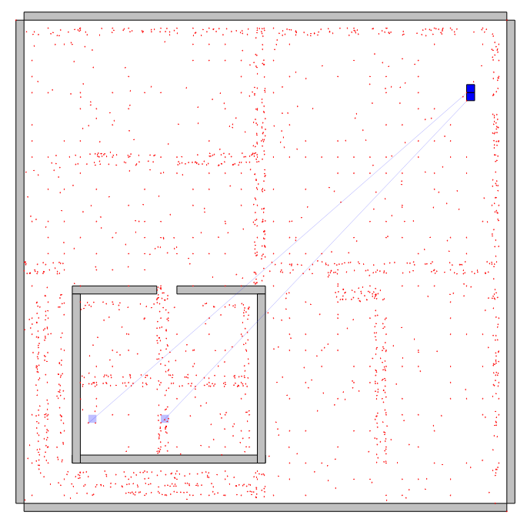
Notes:
N=1000 with no reward

Slide 42
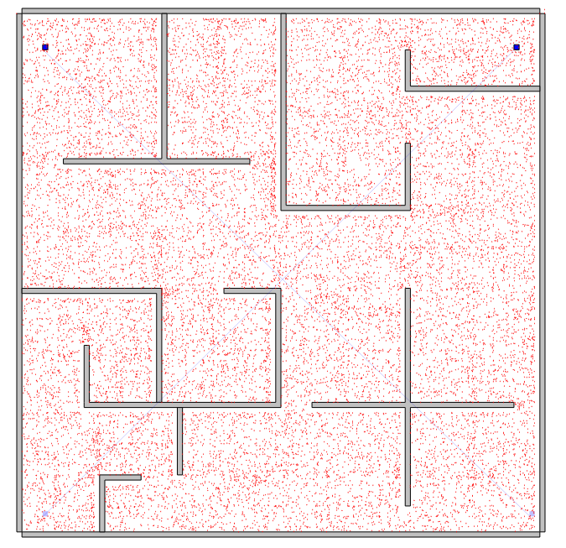
Notes:
N=10000 with adjusted reward

Slide 43
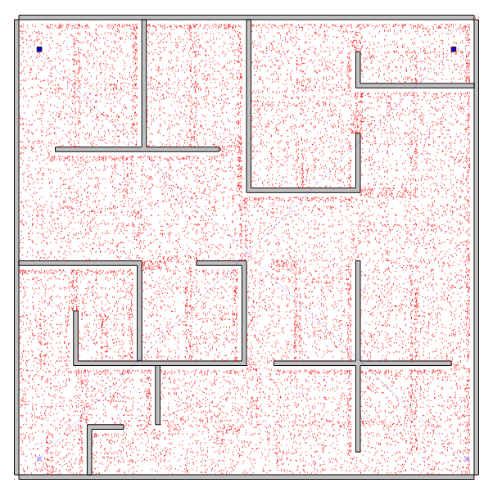
Notes:
N=10000 with reward

Slide 44
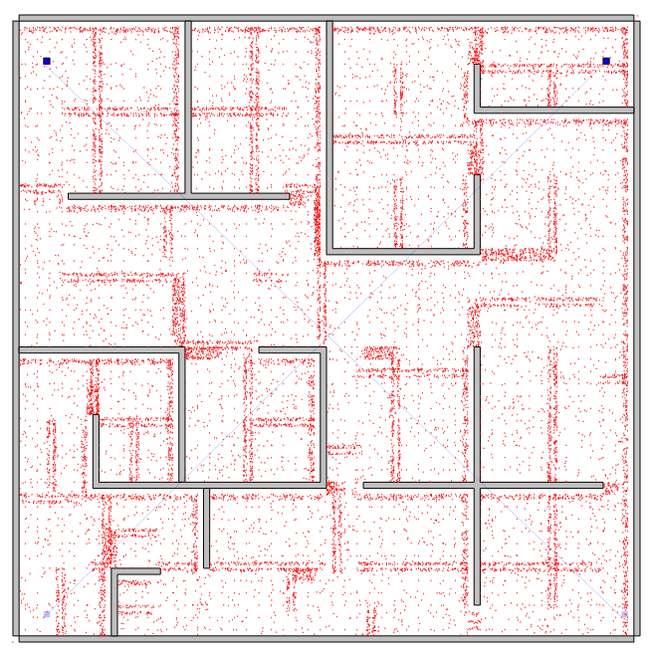
Notes:
N=10000 with no reward

